Slide 1
E-retail factors for customer activation and retention:
A case study from Indian e-commerce customers

Slide 2
Table of contents
1. Introduction
2. Data Visualization
3. Interpretation of Results
4. Conclusion

Slide 3
INTRODUCTION

Slide 4
Problem Statement:
Customer satisfaction has emerged as one of the most important factors that guarantee the success of online store; it has been posited as a key stimulant of purchase, repurchase intentions and customer loyalty. A comprehensive review of the literature, theories and models have been carried out to propose the models for customer activation and customer retention.
Five major factors that contributed to the success of an e-commerce store have been identified as:
1.Service quality
2.System quality
3.Information quality
4.Trust
5.Net benefit.
The research furthermore investigated the factors that influence the online customers repeat purchase intention. The combination of both utilitarian value and hedonistic values are needed to affect the repeat purchase intention (loyalty) positively. The data is collected from the Indian online shoppers. Results indicate the e-retail success factors, which are very much critical for customer satisfaction.

Slide 5
Data sources and formats
The data is from the Indian online shoppers. The work has focused upon customer satisfaction and purchase decisions.
The dataset is provided by FlipRobo Technologies. The data is collected from the Indian online shoppers through conducting the survey. There are two sheets in the dataset one is detailed and the second is encoded in the excel file.
This data set contains 269 records and 71 variables. All the variables are related to customers shopping feedback.

Slide 6
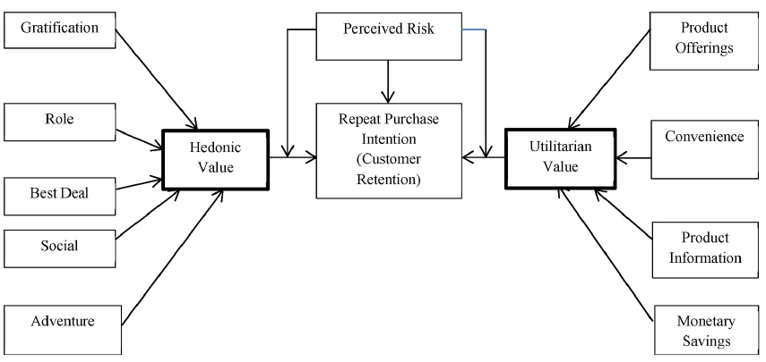
Customers Retention model: This model includes two values hedonic values and utilitarian values. Based on hedonic and utilitarian values we conclude customer’s retention model or customers purchase intention.

Slide 7
Problem Solving Approaches
We follow the below mentioned approach to get the best predictive model:
Data preparation
Data cleaning
Data analysis
Conclusion

Slide 8
Data preparation and cleaning
Cleaning or pre-processing of data is sort through techniques as mentioned below.
Null values and negative values present in the data are checked. With this set of data there is no null value and negative value found.

Slide 9
DATA
VISUALIZATION

Slide 10
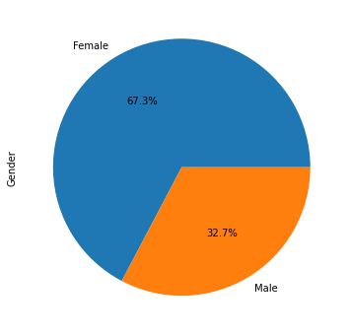
Gender
The Female ratio is more:67.3% .
The male ratio is less:32.7%.
Gender of the respondent showed that number of the female is higher than number of male.

Slide 11
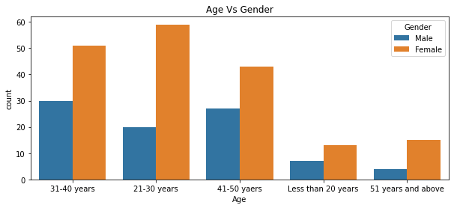
Age
We've 5 categories:
  Less than 20 years.
  21-30 years.
  31-40 years.
  41-50 years.
  51 years and above.
The persons whose age lies between 21 to 50 have maximum chance that they will prefer online shopping. We can say this is because of the persons in the age group 21 to 50 are more tech savvy.

Slide 12
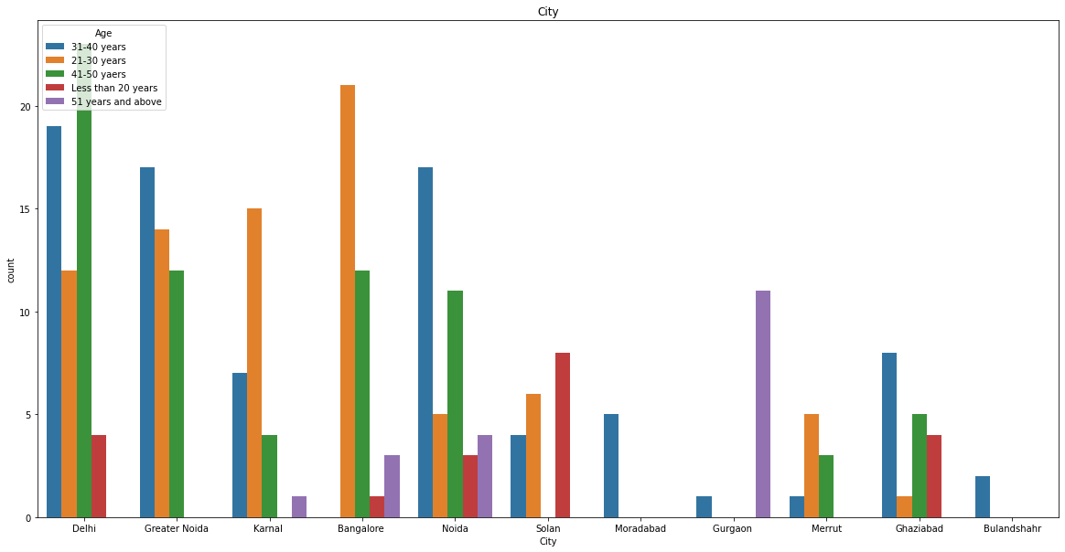
City
CITIES
Delhi 58
Greater Noida 43
Noida 40
Bangalore 37
Karnal 27
Ghaziabad 18
Solan 18
Gurgaon 12
Meerut 9
Moradabad 5
Bulandshahr 2
The cities like Bangalore, Greater Noida, Noida and Karnal shops the most online. And one interesting observation is that people ages above 51yrs shops the most in Gurgaon.

Slide 13
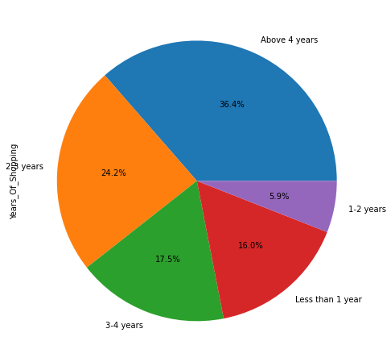
Years Of shopping
Most of the customers are shopping online for more than 4 years, followed by 4 to 3 years, 3 to 2 years, 1 to 2 years and less than 1 year.

Slide 14
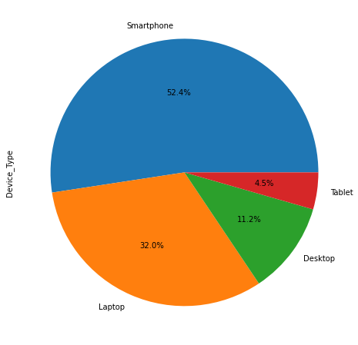
Devices, Os And Internet type Used
Majority of the population uses smart phone for their shopping needs as it is very handy and the least percentage of population uses tablet.

Slide 15
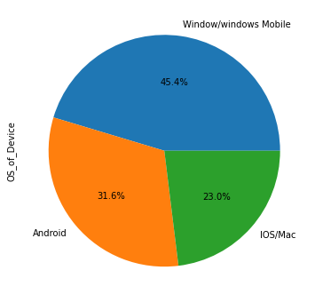
Devices, Os And Internet type Used
We can see The windows user are more than Android and IOS more so because windows are user friendly.

Slide 16
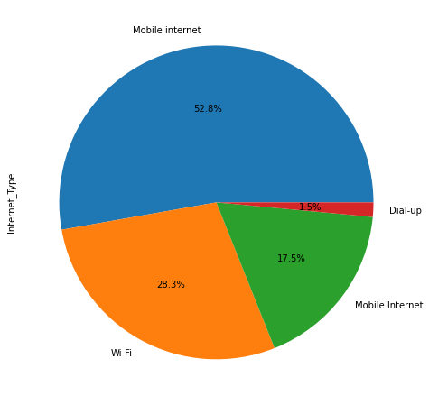
Devices, Os And Internet type Used
53% of the users use mobile internet and only 1.5% of users use dial up.

Slide 17
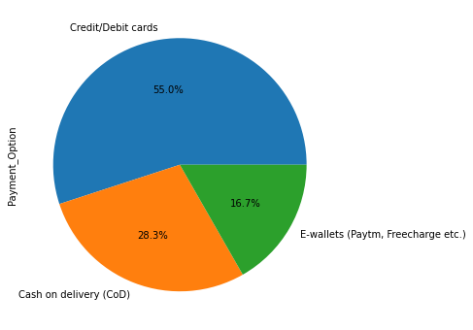
Payment options preferred
Maximum customers uses online method to make the payment while shopping online
Credit/Debit card payment option is most popular payment method among the customers to shop online.

Slide 18
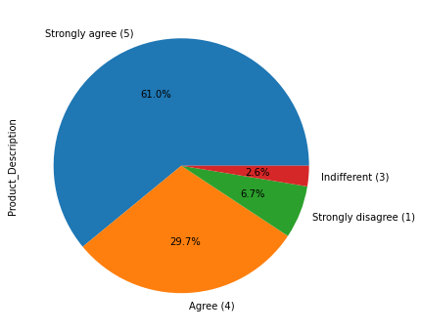
Clear product and quality description
60% of population strongly agree the content of website has to be easy to understand and 30% do agree for the same. so in total approx. 90% of them agree the website should have a neat description.
At the same time the customers also expect to know the quality of the product they plan to purchase.

Slide 19
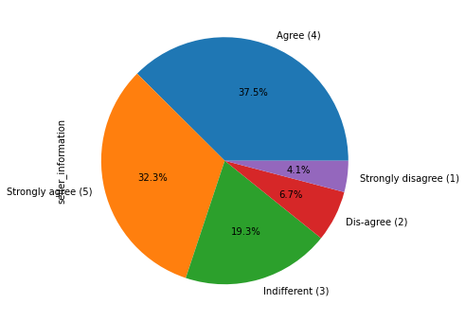
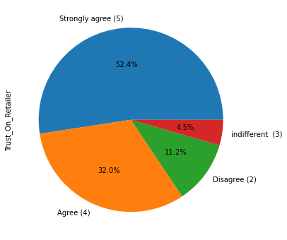
Seller info and trust on retailer
Approximately 70% of people check for complete information of the seller while making a decision to purchase an item. It only shows the trust issues customers might have.
85% people spend on the trust they have on their retailer.

Slide 20
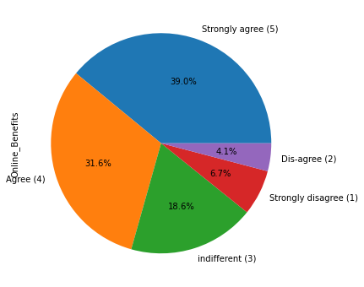
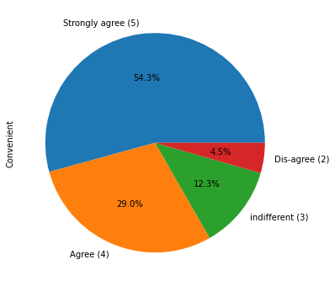
Online benefits and convenient
Most of the customers agrees that online shopping gives them monetary benefit and discounts.
Approx. 84% of people believe it is very convenient to shop online may be because it saves fuel, traffic, time, energy and door step delivery.

Slide 21
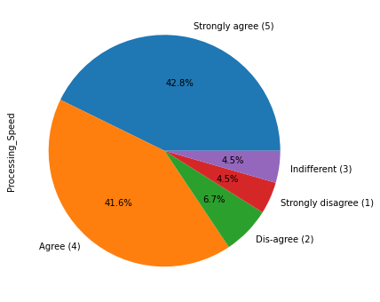
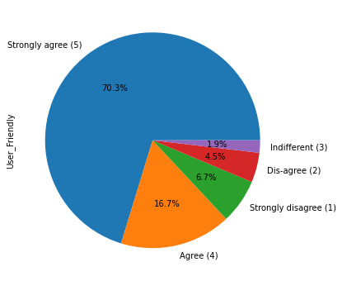
Processing speed and user friendly website
87% people vouch to have a user friendly website. It also helps a layman shop online.
83% People prefers having a good processing speed is a need for their e shopping which also provides easy page to page navigation.

Slide 22
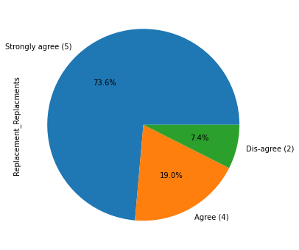
Returns and replacements
93% of people shops online believes to make a purchase in e store only when they have a guaranteed return/replacement policy as many time the picture on product description may be deceiving.

Slide 23
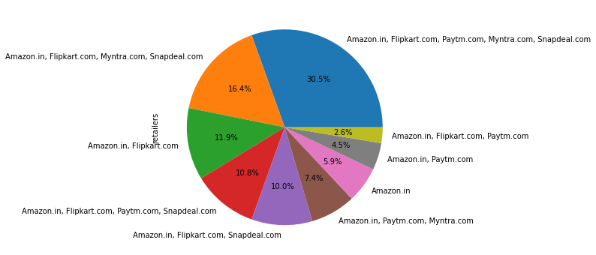
Retailers on market
Since we see that all the sections of the graph highlights amazon, most of the customers use amazon for their e shopping.

Slide 24
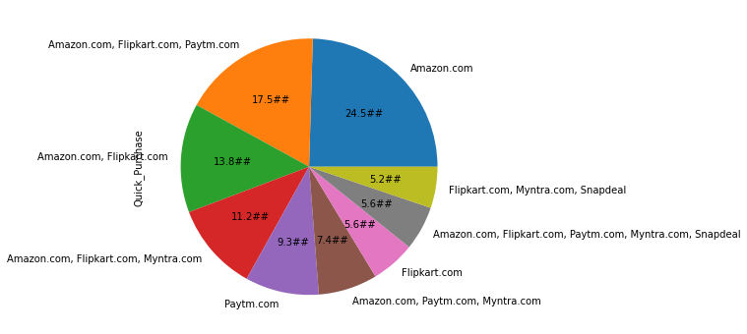
Quickness to complete the purchase
The graph shows that amazon.in have quickness to complete purchase.

Slide 25
Interpretation of results

Slide 26
Top five companies preferred by Indian Customers:
Amazon
Flipkart
Paytm
Snapdeal
Myntra
Most customers found amazon.in very easy to use. Mainly for its visual appearance that is best among all the online retail websites/applications. Amazon.in and flipkart.com are selected by most of the customers as these websites have a wide variety of products listed
If we talk about the complete, relevant information related to the products, most of the customers go with amazon.in and flipkart.com

Slide 27
Mentioning about the website/application speed and page loading time, amazon.in takes the lead followed by flipkart.com and paytm.com.
With quickness to complete the purchase, most of the customers found that Amazon.in is better but flipkart.com and paytm.com also give tough competition.
Speed of delivery: Amazon is taking lead in this category also followed by flipkart.com.
Privacy of customers and their financial information: Amazon is takes lead in this category to. Flipkart.com is also providing better security options for customers.
With trust of the customers in the online retailers, Amazon and Flipkart are winners.
As with customers, amazon.in is as efficient as it was earlier.
Most of the customers would recommend amazon.in and flipkart.com to their friends. This shows that the majority of the customers have trust in these two companies.

Slide 28
Key Findings and Conclusions
The E-Retailers focusing on their customers retention has few things to keep there focus on:
Customer satisfaction
Customer privacy and secured payments.
Monetary Benefits for customers.
Loyalty programs.
User friendly websites.
Easy navigation and similar product listing.
Faster deliveries.
Easy return and replacement policies.

Slide 29
Thank you!

